Slide 1

DeepSORT Part II
Training Our Custom Tracker

Slide 2
Training our own feature extractor
Since, the original DeepSORT focused on MARS dataset, which is based on people, the feature extractor is trained on humans.
We need an equivalent feature extractor for vehicles.
We shall be training a Siamese network for the same.

Slide 3

Siamese Nets
We shall be using a Siamese network with a triplet loss function for our task.

Slide 4

Siamese Nets
Siamese nets are known to work great for feature matching problems as they are trained to keep together data points of similar features and at the same time, learn to keep the entire group far away from other such groups.

Slide 5

Siamese Nets
This is exactly what we need, as we want the same ID for a vehicle in different views and different IDs for different vehicles.

Slide 6

Siamese Nets
So, to achieve this desired result, during training, we take 3 images
-> the anchor (which is the training image),
-> a positive (another image from the same class as the anchor),
-> and a negative (another image from any other class).

Slide 7
Siamese Nets
The objective of the loss function of the CNN network would be to minimize the cosine distance between feature vectors of anchor and the positive image and simultaneously maximize the cosine distance between feature vectors of anchor and the negative image.

Slide 8

Siamese Nets
The loss is illustrated below (Note that 1 is similar and 0 is dissimilar in cosine metric)
distance_positive = F.cosine_similarity(anchor,positive)
distance_negative = F.cosine_similarity(anchor,negative) loss = (1- distance_positive)**2 + (0 - distance_negative)**2

Slide 9

Siamese Nets
we can go through the network configurations and the various options in siamese_net.py and siamese_dataloader.py

Slide 10
Siamese Nets
siamese_net.py has the network configuration.
The net consists entirely of CNN layers and batch normalization.
It also has the definitions for both contrastive and triplet loss functions.

Slide 11
Siamese Nets
siamese_dataloader.py has the definitions for the unique data loader we would be requiring for our task.
It has functions to randomly select the anchor, positive and negative images and apply any required data augmentations.

Slide 12
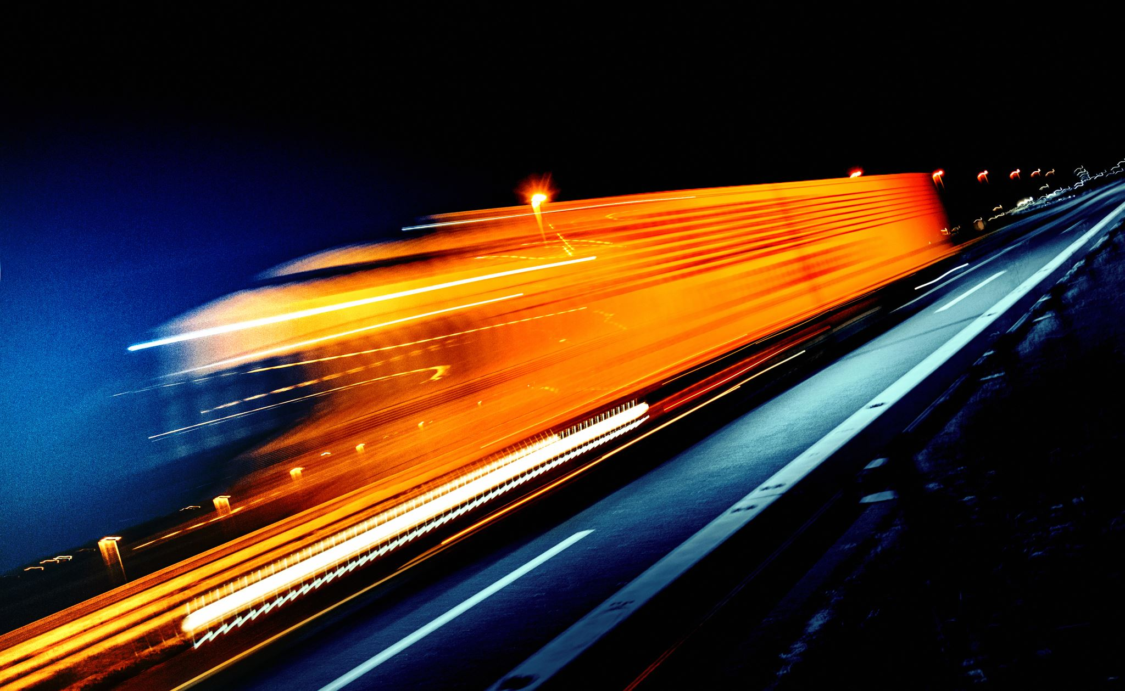
Siamese Nets
siamese_train.py has the code to train our network.
Since we are dealing with cropped outputs from an object detector, the boxes might not be a perfect fit;
Hence, there is a possibility of background elements influencing the values of the feature vector.

Slide 13

Siamese Nets
In order to avoid that, we multiply the input training image with a 2D-Gaussian mask.
This will act like a visual attention mechanism, by forcing the network to focus more on the center of the cropped image and give less importance to the background elements.
The get_gaussian_mask function takes care of this.

Slide 14

Siamese Nets
Since, we have trained our network with a gaussian mask, it only makes sense to continue to use the same during inference as well.
So, we have the self.gaussian_mask variable in deepsort.py which is used during inference.

Slide 15
Siamese Nets
siamese_test.py lets us know the accuracy of the trained feature vector by randomly sampling images and comparing them with distances from negatives and positives.

Slide 16
Siamese Nets
Now that our own feature extractor is trained and tested, we are ready to launch our custom object tracker!
We just must follow the stub code given in test_on_video.py to build your own program flows.

Slide 17
Conclusion
I hope this presentation has helped you gain a comprehensive understanding of the core ideas and components in object tracking and acquainted you with the tools required to build your own custom object detector.

